Slide 1


Springboard Data Science Guided Capstone Project Report
By: Bini Teklehaimanot

Slide 2
Agenda
Problem Identification
Recommendation and Key Findings
Modeling Results and Analysis
Summary and Conclusion

Slide 3
Problem Identification
Leverage Existing Facilities
Adjust Pricing Strategies
Increase Revenue by more than $1.54M

Slide 4
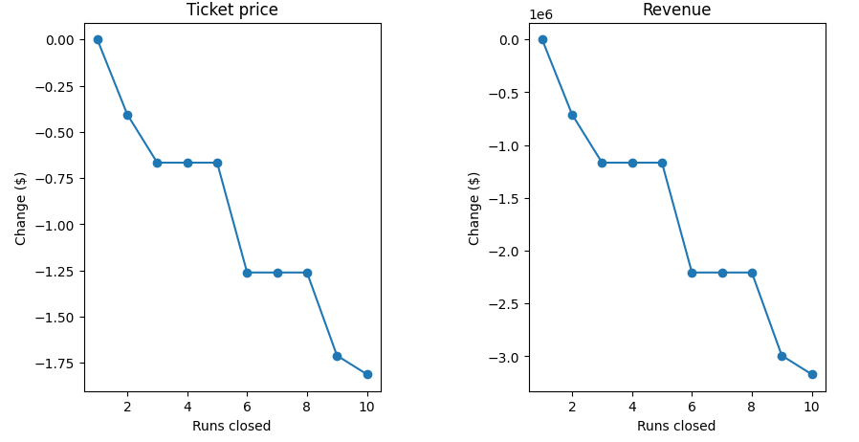

Recommendations and Key Findings
Increase price starting at $5 and gradually going to $9-$10
At $9.90, revenue is $17.3M / Season
Closing more than one run decreases revenue (left chart)
Adding 2 acres of snowmaking

Slide 5
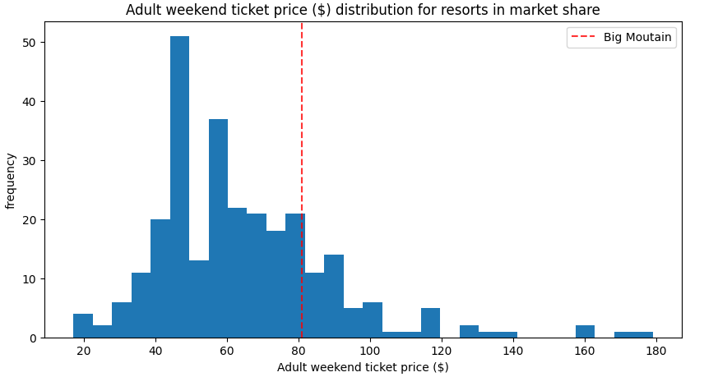
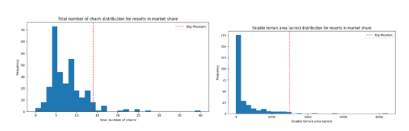
Modeling Results and Analysis
Ticket price closer to the tail of the distribution
More chairlifts than most of the competition
At the tail end of the skiable area distribution

Slide 6
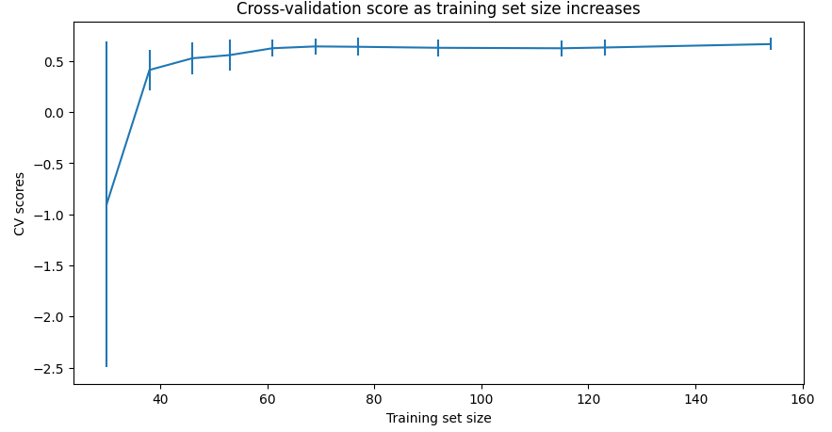
Summary and Conclusion
Random Forest Model is chosen for its effectiveness in pricing strategy
Random Forest Model allows for increasing ticket price by $9-$10
Translates to a revenue per season of $17.3M
Importance of Current Pricing Strategy
Essential for determining the best price for the new strategy
Additional data not required

